Slide 1



END OF STUDIES PROJECT PRESENTATION
Elaborated by: Yakoubi Iheb
Layouni Yassine
Pedagogical supervisor: Mme. Jebli khouloud
Company supervisor: Mr. Fayachi Ahmed
Company: PROSOFT INTERNATIONAL
Academic year: 2020/2021
Notes:
Iheb : Good morning, first of all, we are honored to present to you our end of studies project, my name is iheb yakoubi and (Yassine : and i am yassine layouni)

Slide 2

TABLE OF CONTENTS
01
02
03
04
PROJECT ENVIRONMENT
INTRODUCTION
STUDY OF THE ART
REQUIREMENTS SPECIFICATION
05
DESIGN
06
REALIZATION
01
07
CONCLUSION
Notes:
Yassine : Our plan for this presentation includes the following chapters…

Slide 3
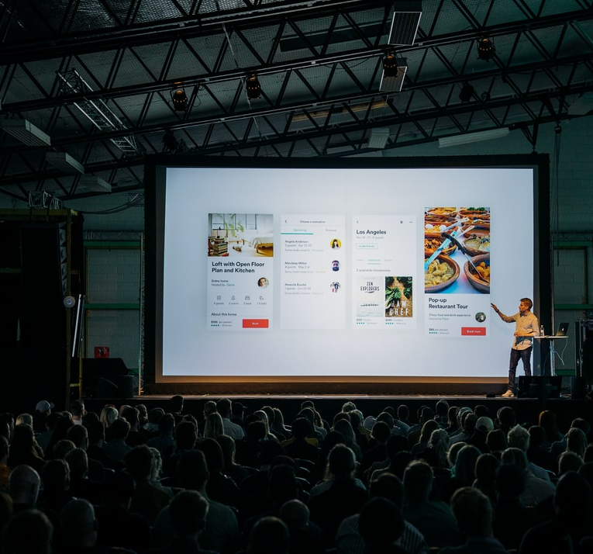
01
INTRODUCTION
02

Slide 4

ROBIN
A chatbot that facilitates the use of the applications developed by prosoft international
03
Notes:
Yassine : starting by a little indroduction about our project which is called robin, it is a project that facilitates the use of exisiting financial softwares developed by prosoft international,

Slide 5

02
PROJECT ENVIRONMENT
04
Notes:
Iheb : now we move onto project environment

Slide 6

COMPANY INTRODUCTION
Prosoft International is a company based in Tunis since 2007. It is specialized in the development of specific software in the field of finance.
05
Notes:
Iheb : speaking of prosoft international, it is a development company founded in 2007, its main activity is the development of specific software in the field of finance, it also provides business advice alongside Integration and Maintenance,

Slide 7
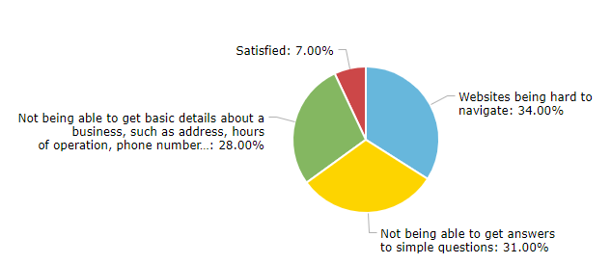
MARKET RESEARCH
06
Notes:
Iheb: according to an online survey created by DRIFT, The most common frustrations reported by internet users included: websites are hard to navigate , the customer not being able to get answers to their questions neither basics details about the buisness

Slide 8

PROBLEMATIC
Consumers expect to be able to find the information they’re looking for quickly and easily.
07
Notes:
Iheb: this is due to the complexity of websites, the lack of information that is available to the user, the increase in customer response time and the websites down time for maintenance,

Slide 9
“
—PHILIP ROTLER
IF YOU ARE NOT TAKING CARE OF YOUR CUSTOMERS, YOU COMPETITOR WILL”
08
Notes:
Iheb: and as philip rotler said : «IF YOU ARE NOT TAKING CARE OF YOUR CUSTOMERS, YOU COMPETITOR WILL»

Slide 10
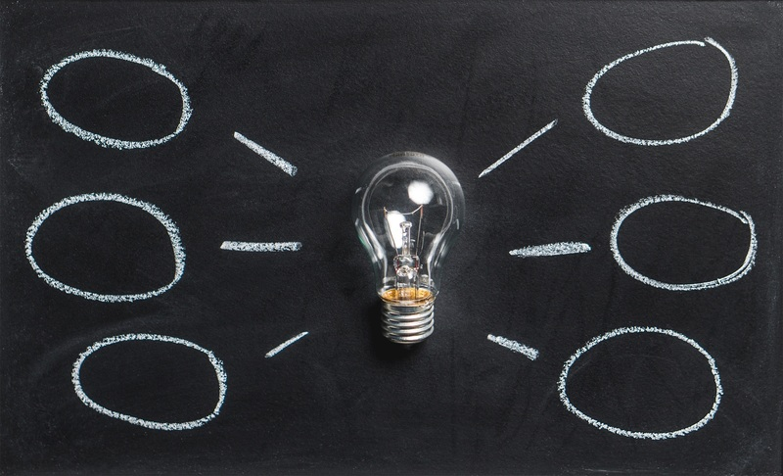
SOLUTION
Our solution is to create an AI-powered chatbot in order to facilitate the human/machine interactions and reduce customer response time.
09
Notes:
Yassine: so, we decided to create a desktop and a mobile application powered by an ai chatbot, that will guide users through the applications that they use, answer their most common questions and execute automated tasks,

Slide 11
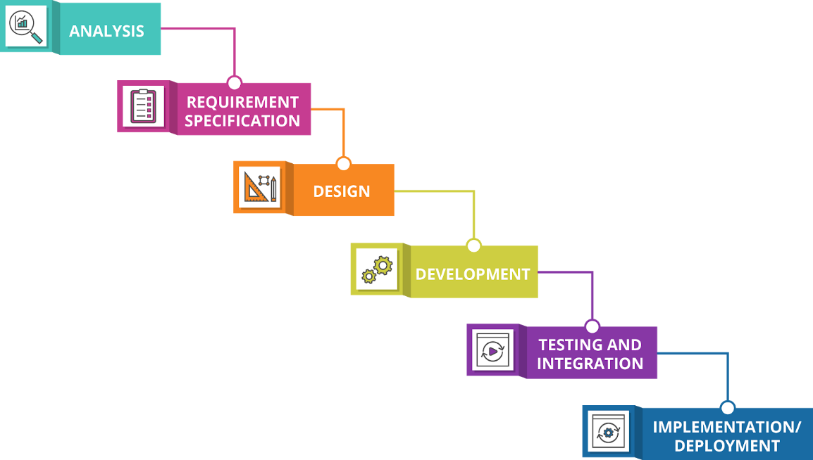
WATERFALL MODEL
10
Notes:
Yassine: To model and design our application, we opted for the waterfall model, because our project requirements are clear and not changing frequently and all of the resources were available to us,
the model is divided into separate phases, Requirement Gathering and analysis , System Design , Implementation, Integration and Testing , Deployment of the system, and finally Maintenance

Slide 12
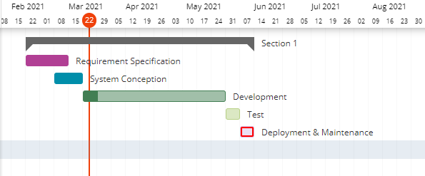
PROVISIONAL PLANNING
11
Notes:
Yassine: and before we end this chapter, this is our provisional planning

Slide 13

03
STUDY OF THE ART
12
Notes:
Iheb : Before we get into the specifics of the project, first we must have a better idea about the domain of our project

Slide 14
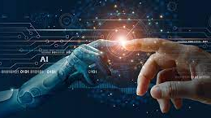
ARTIFICIAL INTELLIGENCE
Artificial intelligence refers to the simulation of human intelligence in machines that are programmed to think like humans and mimic their actions.
13
Notes:
Iheb : Starting with artificial intelligence which refers to the simulation of human intelligence in machines. Its goals include learning, reasoning, and perception and nowadays it is being used across different industries including finance and healthcare.

Slide 15
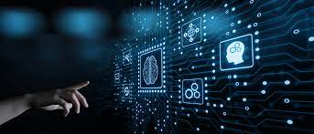
DEEP LEARNING
Deep learning Also known as deep neural learning or deep neural network, is a subset of machine learning in artificial intelligence.
14
Notes:
Iheb : Deep learning Also known as deep neural learning or deep neural network, is a subset of machine learning in artificial intelligence, that has networks capable of learning, and creating patterns for use in decision making.

Slide 16
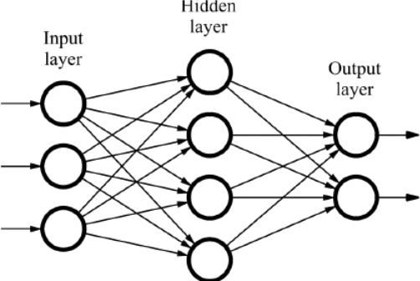
NEURAL NETWORK
15
Notes:
Iheb: speaking of neural network, it is a series of algorithms used in deep learning to make decisions, it contains a minimum of 3 layers, the input layer, the hidden layer and the output layer, these layers form a network of interconnected nodes that help in deciding the best output,

Slide 17

AI POWERED CHATBOT
A chatbot is a computer program that simulates human conversation through text chats using ai algorithms.
16
Notes:
Iheb: A chatbot is a computer program that simulates human conversation through text chats,
There are 2 kinds chatbots, rule based and ai powered chatbots, we opted for the ai chatbot using deep learning

Slide 18
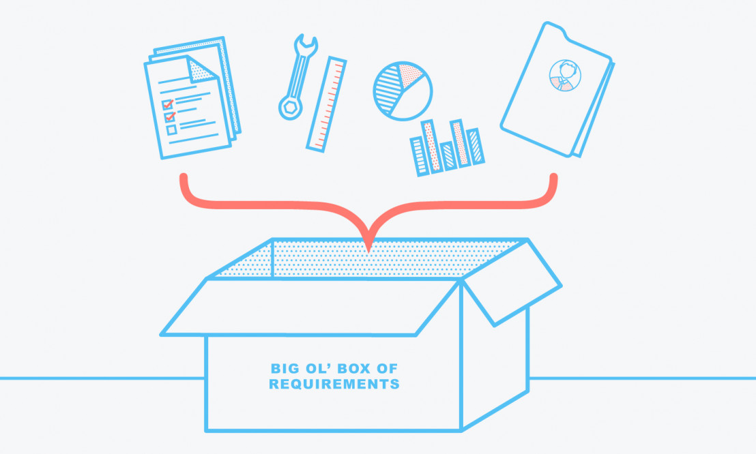
04
REQUIREMENTS SPECIFICATION
17
Notes:
Yassine: now we pass to the third chapter, requirements specification

Slide 19
FUNCTIONAL REQUIREMENTS
01
02
03
04
Manage user accounts
Manage user functions
Interact with the chatbot
Consult and export the data returned by the chatbot
18
Notes:
Yassine: Starting by the functional requirements, that consists of managing the users acounts and functions which have a permission to what a user can do , interacting with the chatbot , consulting and exporting the returned data to an image, pdf or exel file ,

Slide 20
FUNCTIONAL REQUIREMENTS
05
06
07
Consult users history
Consult chatbot statistics
Manage the rules of use of the chatbot
19
Notes:
Yassine: consulting the user,chatbot interaction history and the chatbot statistics to better managing the rules of use which our chatbot depend on it to work

Slide 21
NON FUNCTIONAL REQUIREMENTS
Availability
Security
Performance
Ergonomics
Interoperability
Reusability
20
Notes:
Yassine: as for the non functional requirements ou project insures availability, the chatbot has to remain always in service to interact with the users at any given moment. at all times, it also offers security using jason web token authentication for both the backend and the frontend and also password ecryption
Also we have performance, the chatbot response time has to be fast and fluid,
Our project also offers ergonomics and interoperability, this means the interfaces must be simple and easy to navigate and this application only needs a web browser, in addition it is multiplatform.
And finally we have reusibility, the application is created using services so it can provide the option to modify and reuse the code.

Slide 22
GLOBAL USE CASE DIAGRAM
21
Notes:
iheb

Slide 23
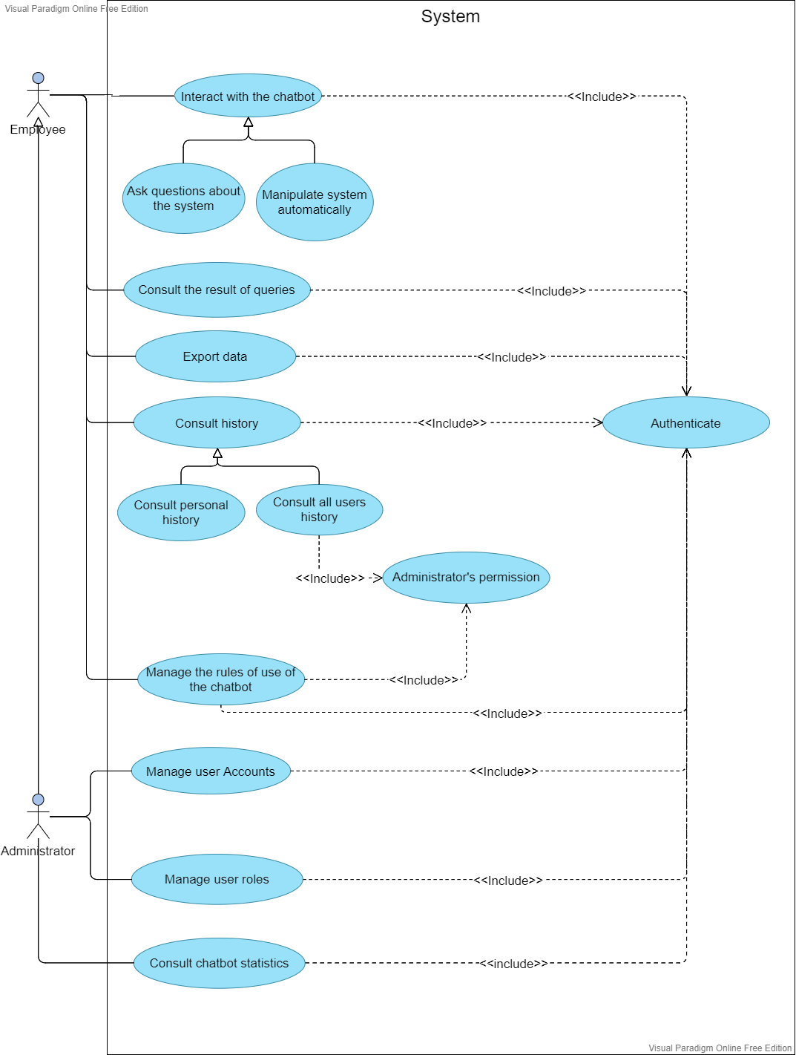
22
Notes:
Iheb: for our global use case diagram we have two actors the first one is the employee who can interact with the chatbot by asking questions or manipulating the system, he can also consult the results returned by the chatbot and export it like i said in the functional requirement part, consult his own history if his function’s permission don’t allow him to view others history , and if he have it he can consult all users history, he needs also a permission to manage the rules of use of the chatbot. In addition to what the employee can do the administrator can manage user acounts , roles and consult the statistics of the chatbot , of cours all these use case needs an authentification.

Slide 24

05
DESIGN
23
Notes:
Yassine: after we specified our project’s requirements, now dive into the design chapter

Slide 25
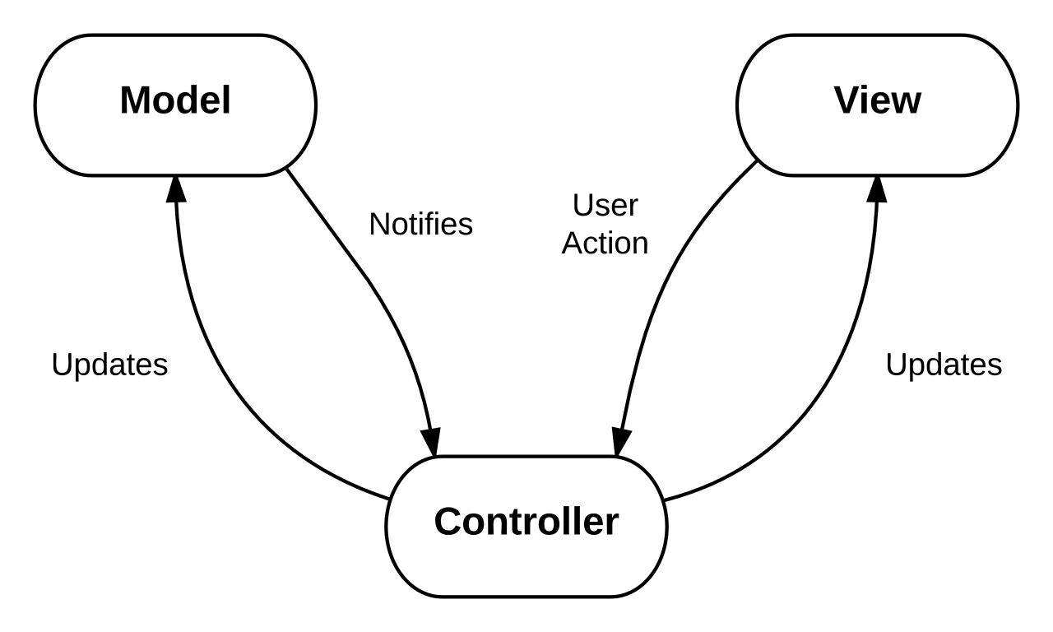
MVC ARCHITECTURE
24
Notes:
Yassine: for the frontend architecture we used angular wich inherently uses the The Model-View-Controller (MVC) architecture, it is a pattern that separates an application into three main logical components: the model, the view, and the controller. Each of these components are built to handle specific development aspects of an application.

Slide 26
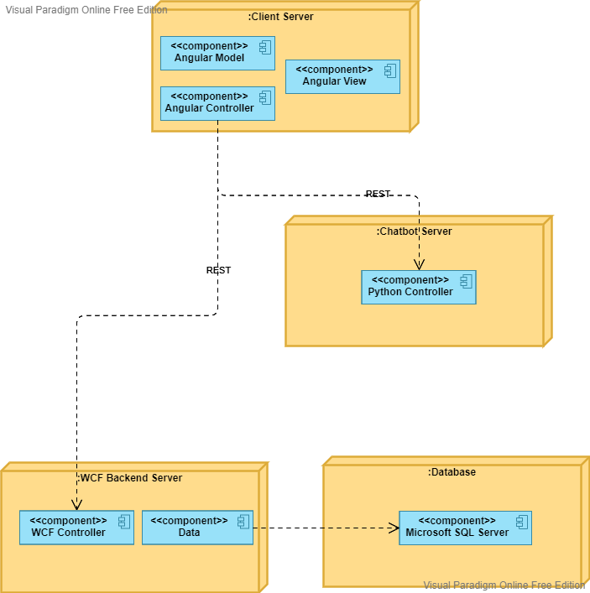
DEPLOYMENT DIAGRAM (N-TIER ARCHITECTURE)
25
Notes:
Iheb: for the deployment diagram, we have the angular or the client server, containing a view, model and controller, each controller communicates withe both the chatbot and the backend servers using Representational State Transfer requests, the chatbot server contains a python controller and the wcf server has a wcf controller and a data component wich communicates with the Microsoft SQL server database,

Slide 27
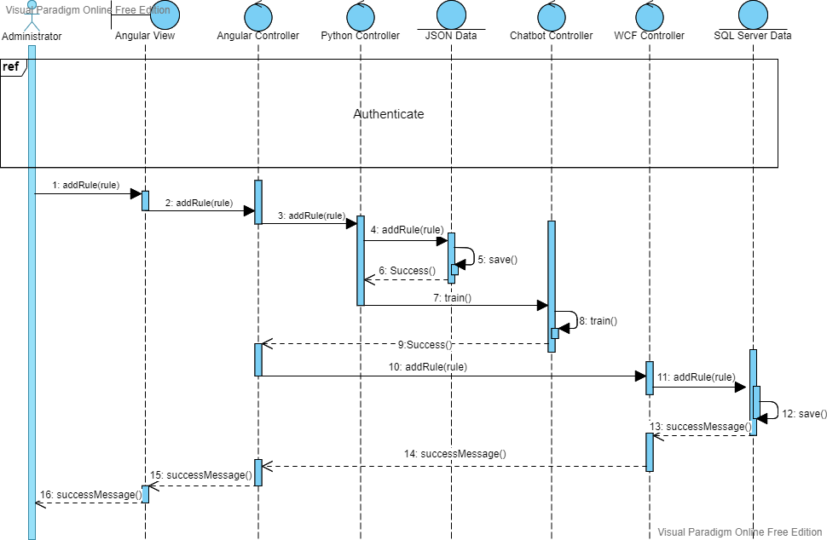
ADD RULE SEQUENCE DIAGRAM
26
Notes:
Iheb: we have here the add rule sequence diagram that starts with the authentication of the administrator, when the actor presses the add rule button, the rule is first added to the chatbot’s json data, which will initiate the training, then the rule will be saved in the database, asuming the operation is successfull the administrator receives a success message,

Slide 28
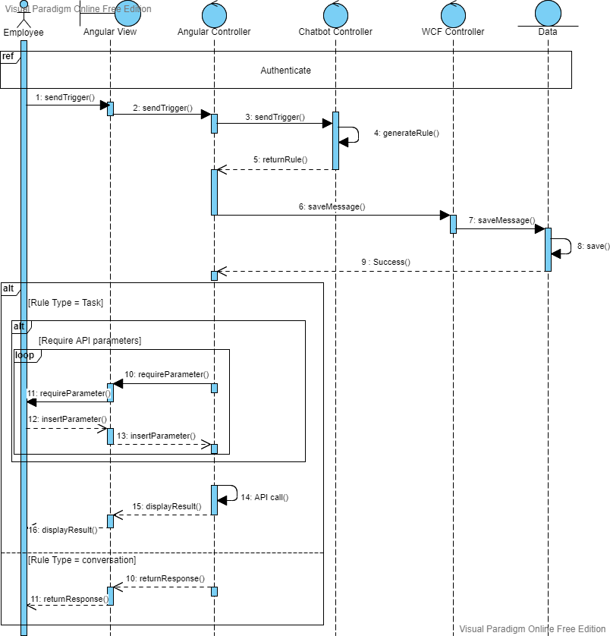
CHATBOT INTERACTION SEQUENCE DIAGRAM
27
Notes:
Yassine: this is the chatbot interaction sequence diagram that allows the use to converse with the chatbot and execute tasks, this starts with the authentication of the user, then when the user presses the send button, the input message is sent to the chatbot, using deep learning algorithms the chatbot analyses the message and selects the appropriate rule to send it back to the angular controller, before angular displays the response first it sends the message to the backend so it can be added in the user history, afterwards if the rule is a task, the chatbot starts a sequence of questions if the task has attribues for exemple username, or date or something like that, after that the chatbot executes the rule and displays the result statistics, matrix portfolio or a simple value, however if the rule is a conversations then angular simply displays a random response

Slide 29
CLASS DIAGRAM
28

Slide 30
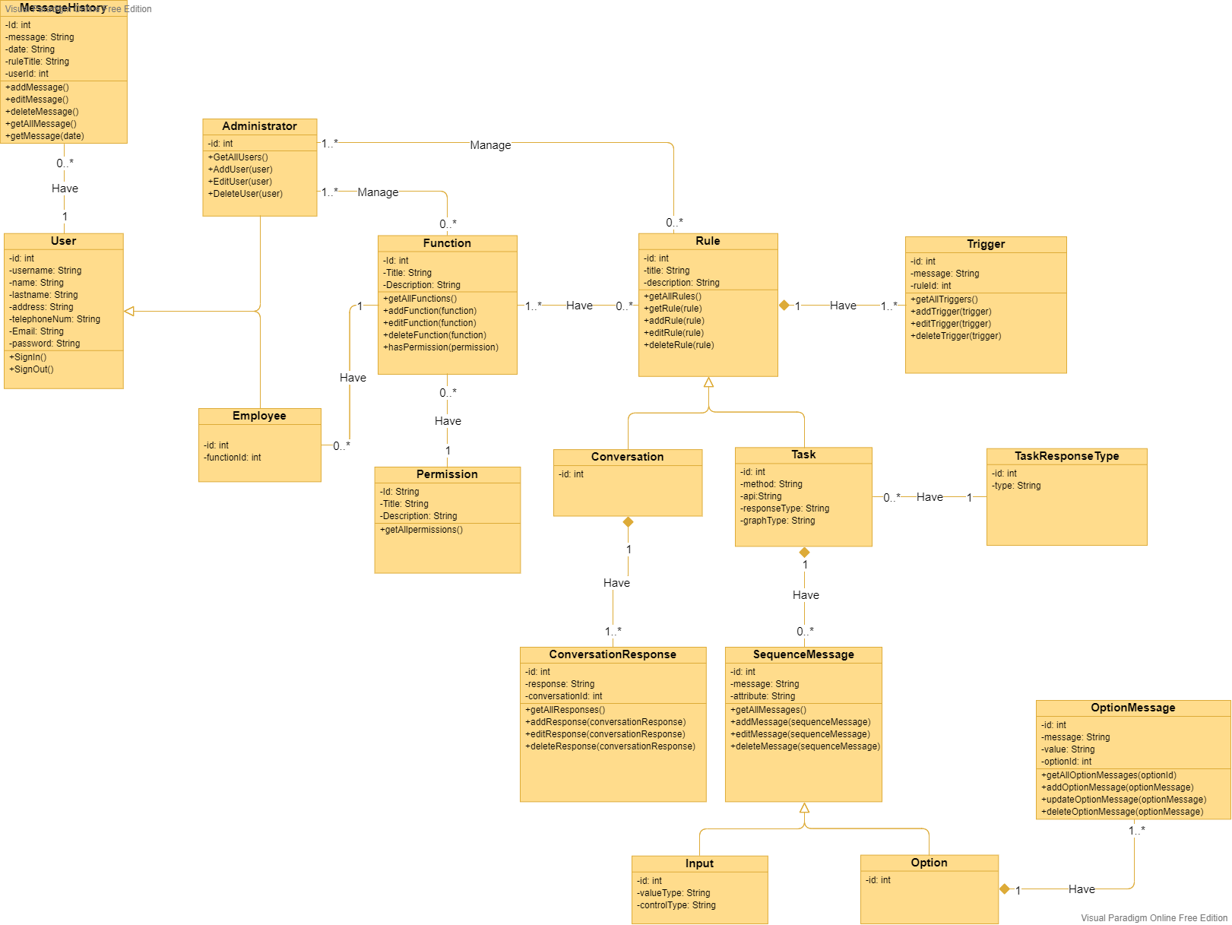
29
Notes:
Iheb: our class diagram contains 16 entities, we have the user table identified by the id .the user can be an administrator or an employee and each user has multiple messageHistory identified by an id and contains the message, the ruleTitle and the userId, also every user has a single function which is identified by an id containing a title and a description, each function itself has one permission determining what the user can do in our system
Yassine: ,,,

Slide 31
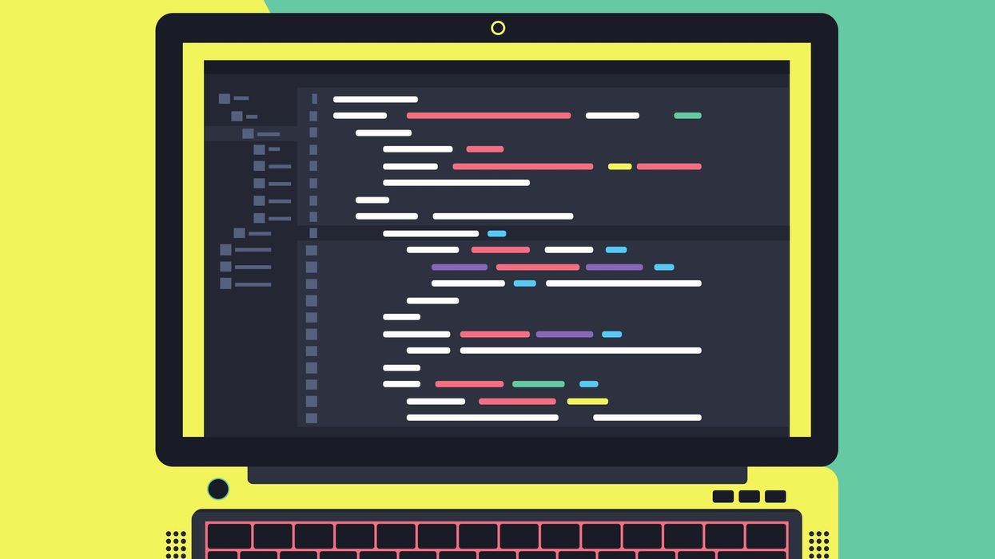
06
REALIZATION
30
Notes:
Yassine: our fifth chapter is realization,

Slide 32



SOFTWARE ENVIRONMENT
31
Notes:
Yassine: for the devopment of our project we used angular for the frontend which is a platform and framework for building single-page client applications using HTML and TypeScript, we used python for the creation of the chatbot using natural language toolkit and tensorFlow as libraries, we used windows communication foundation for the backend services

Slide 33


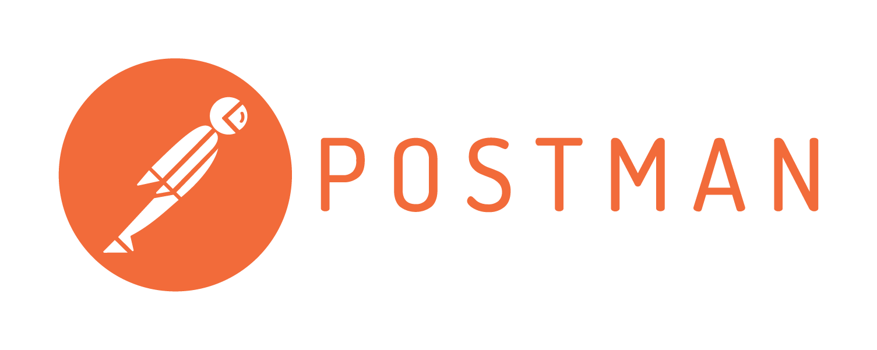
SOFTWARE ENVIRONMENT
32
Notes:
Yassine: alongside Microsoft SQL server as database, cordodva for the creation of the mobile version of our project, cordova allows to create mobile applications using HTML, CSS & Javascript, and finally we chose postman for the integrations tests.

Slide 34
MAIN GRAPHICAL INTERFACES
33

Slide 35
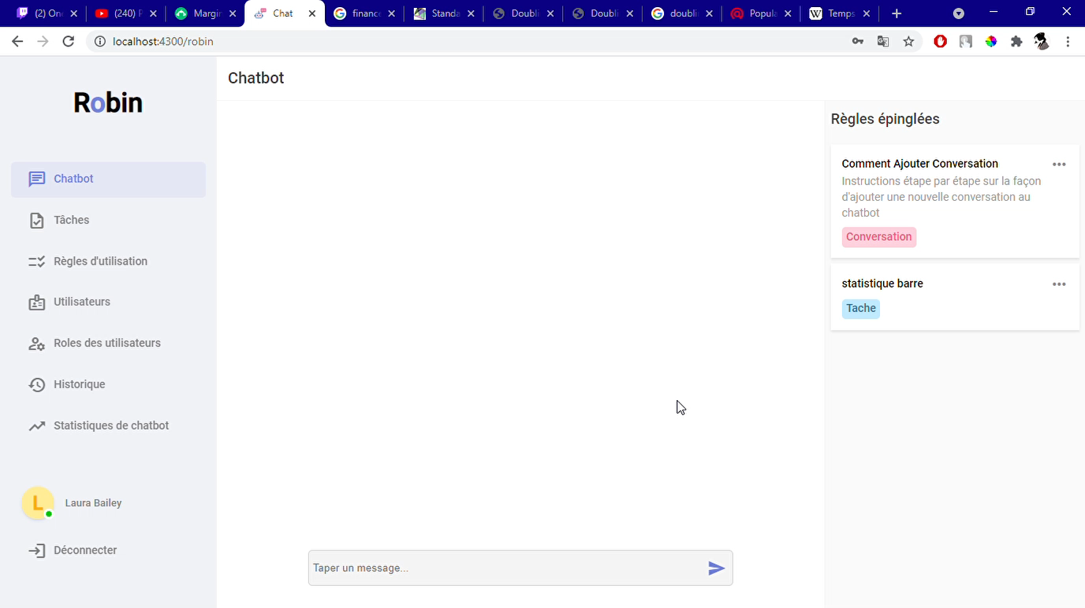
CHATBOT CONVERSATION
34
Notes:
Yassine: Comment on video

Slide 36
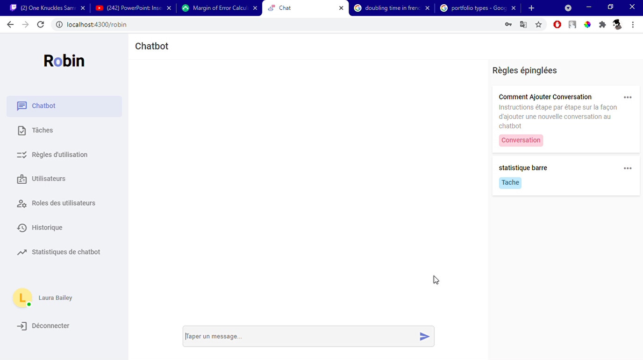
CHATBOT TASK
35
Notes:
Yassine: Comment on video

Slide 37
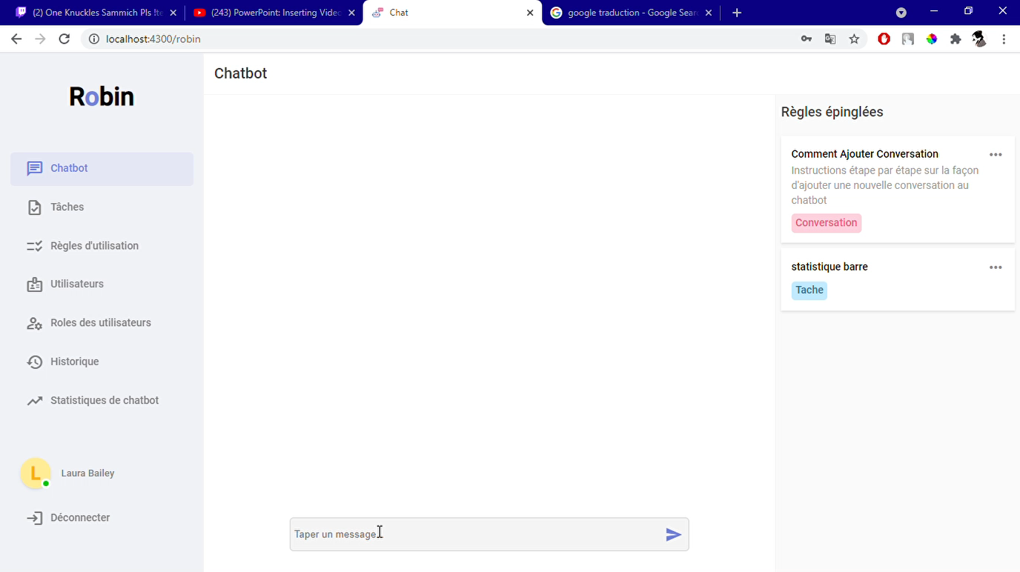
CHATBOT STATISTICS RESULT
36
Notes:
Yassine: Comment on video

Slide 38
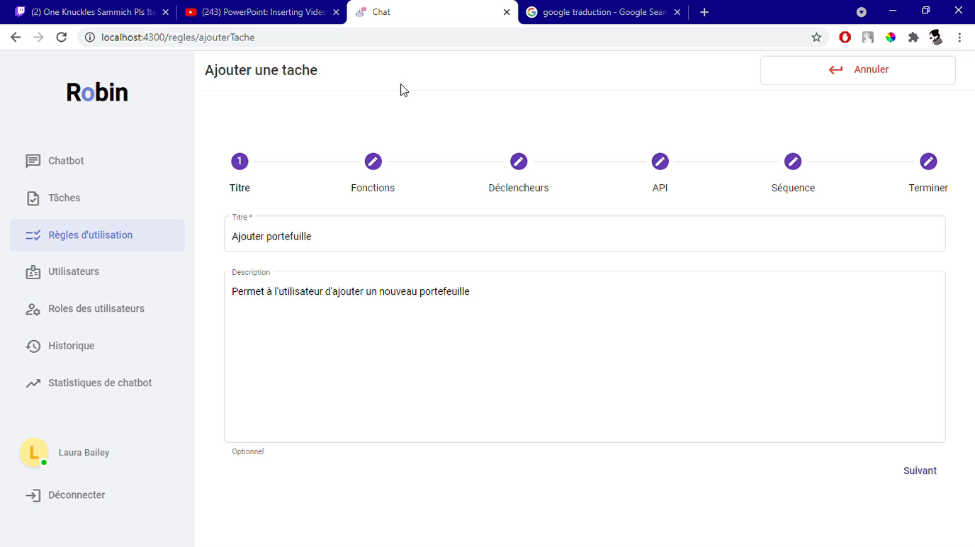
ADD A NEW TASK
37
Notes:
Yassine: Comment on video

Slide 39
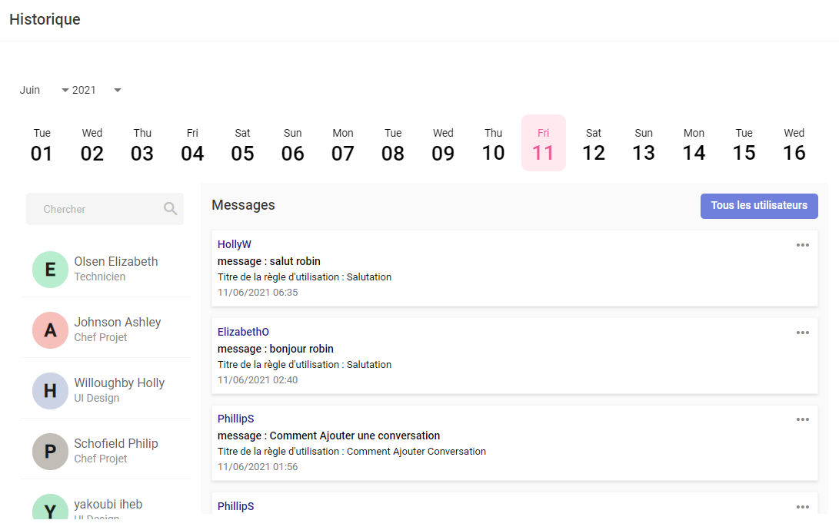
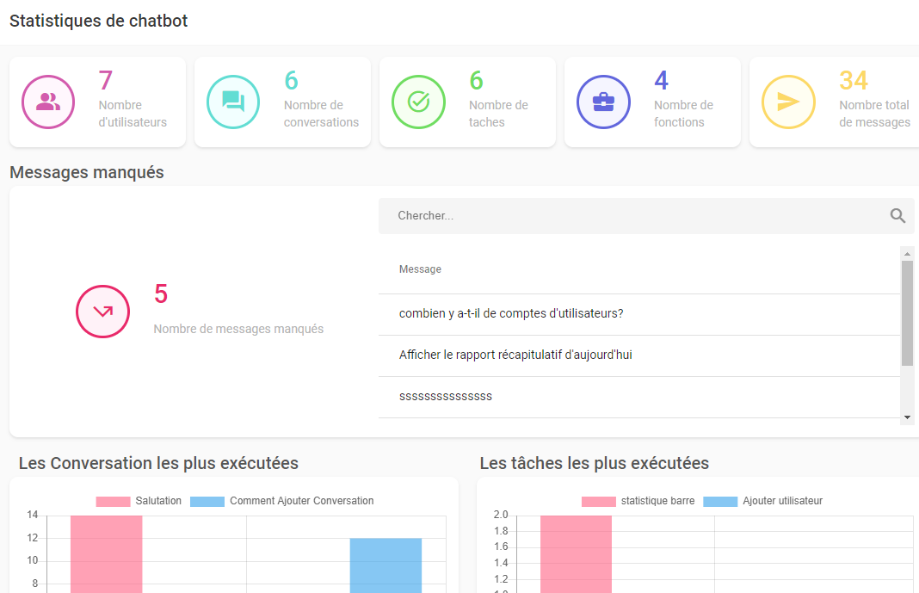
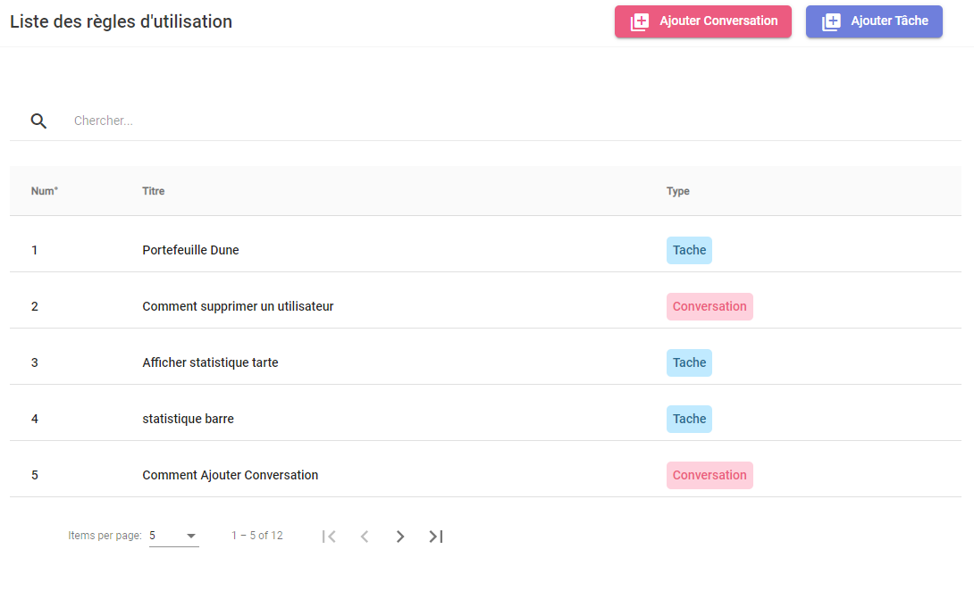
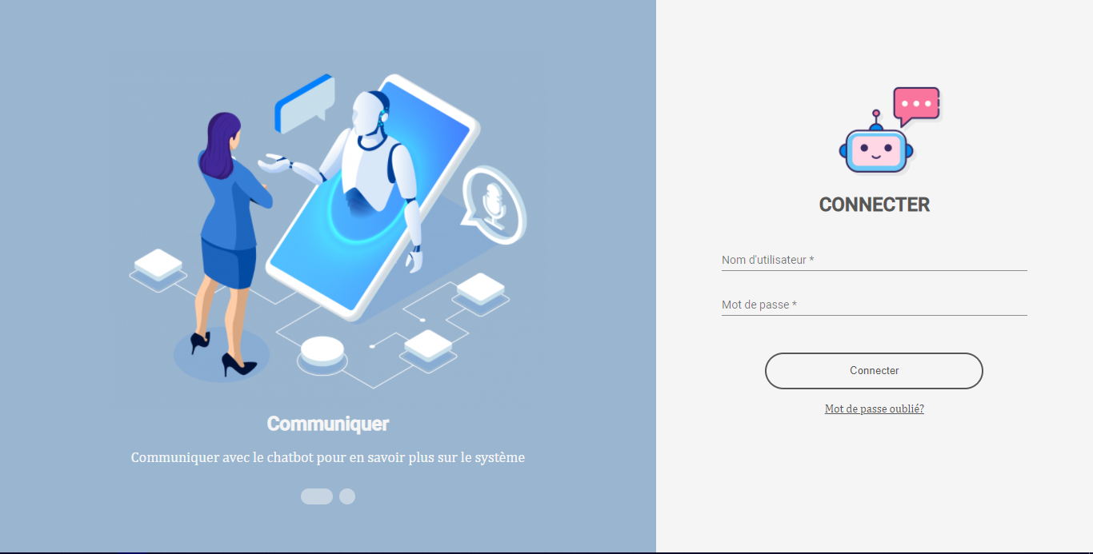
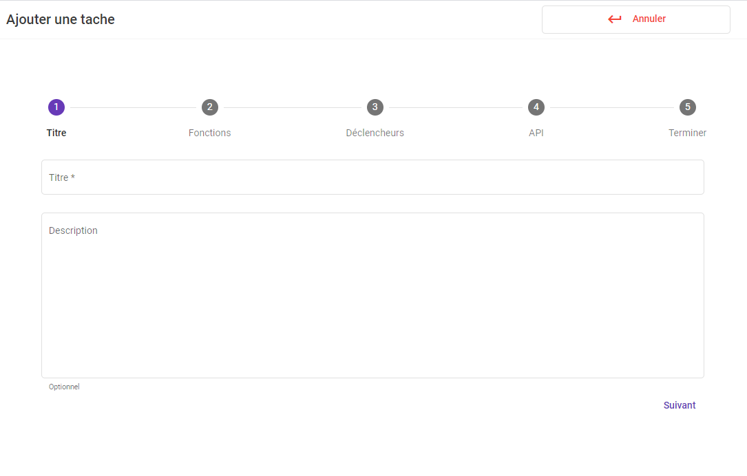
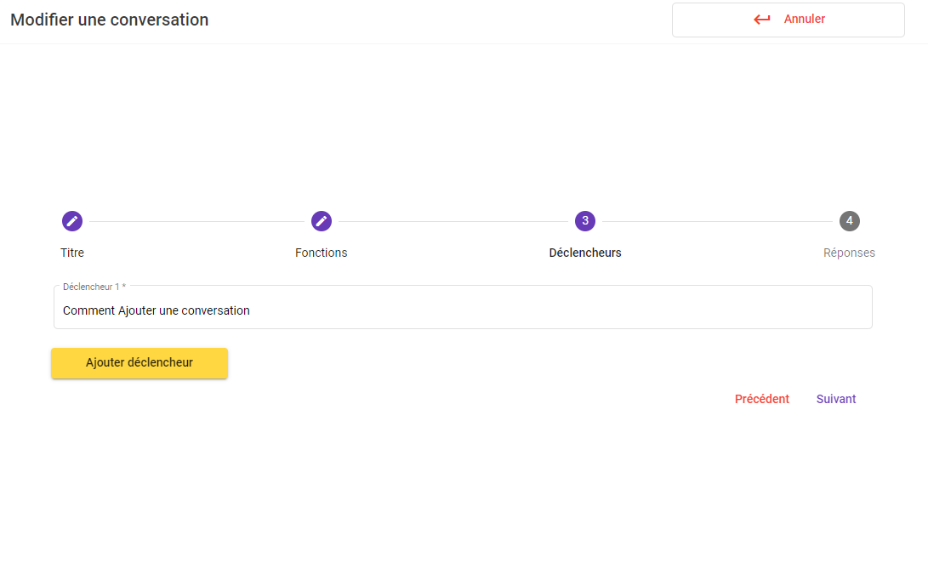
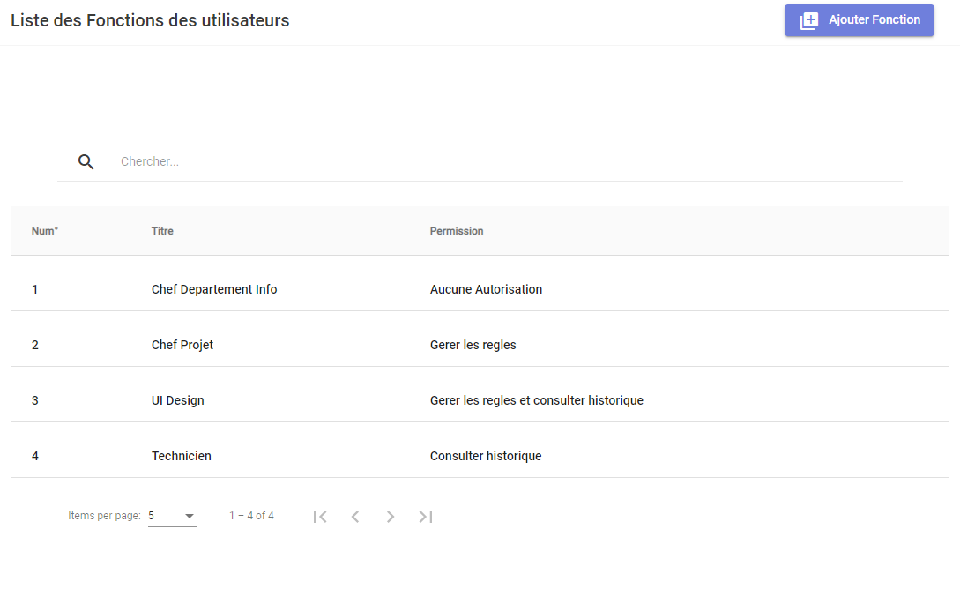
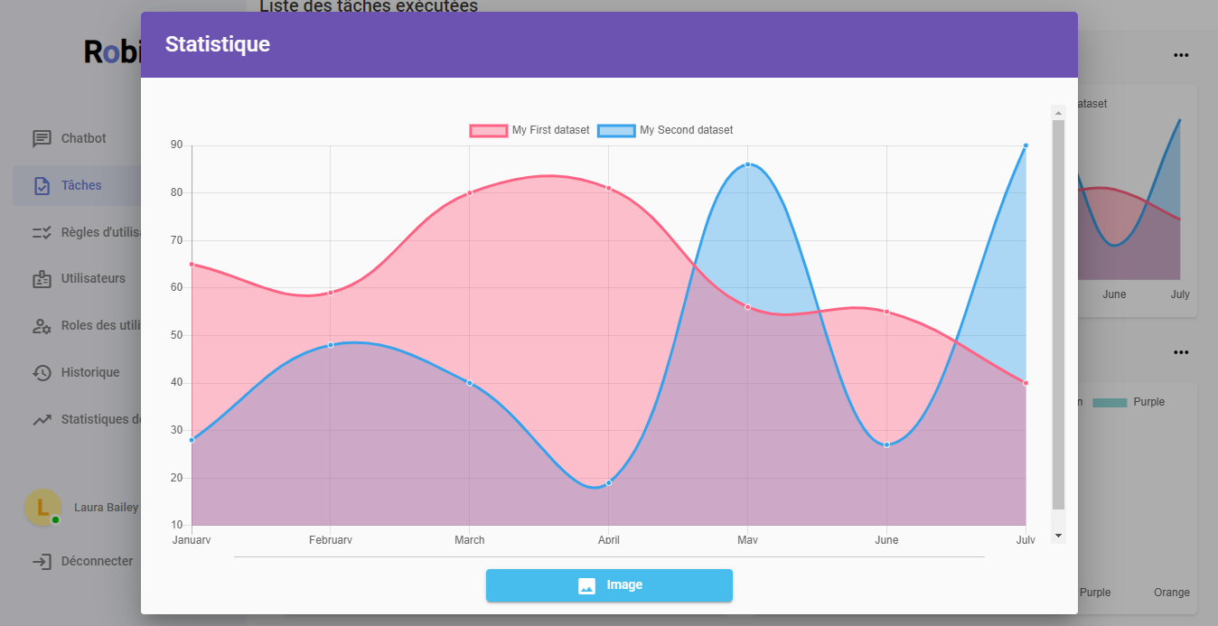
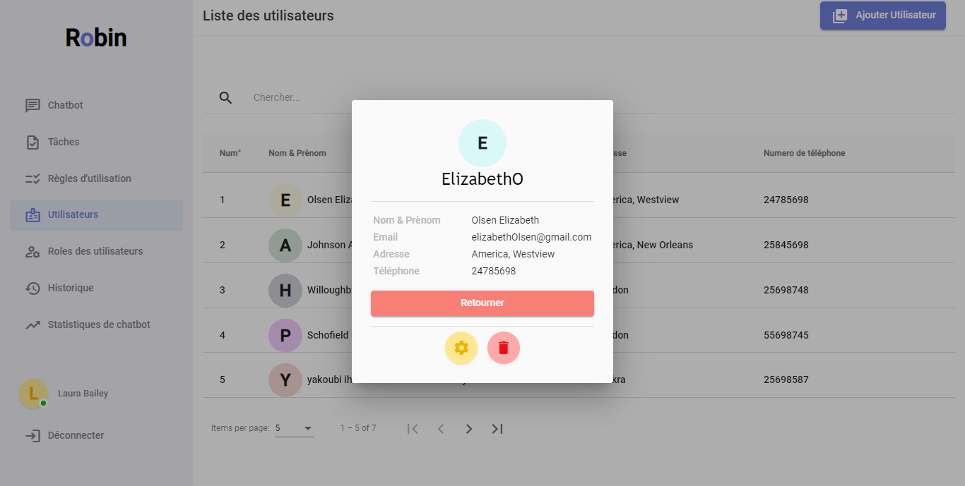
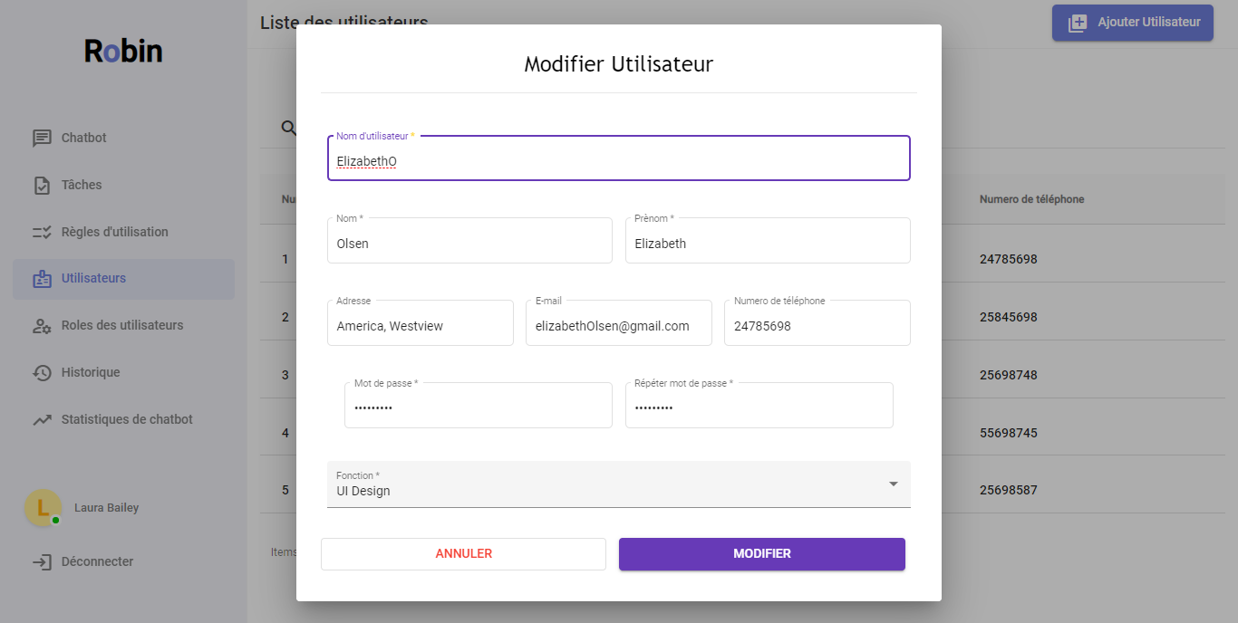
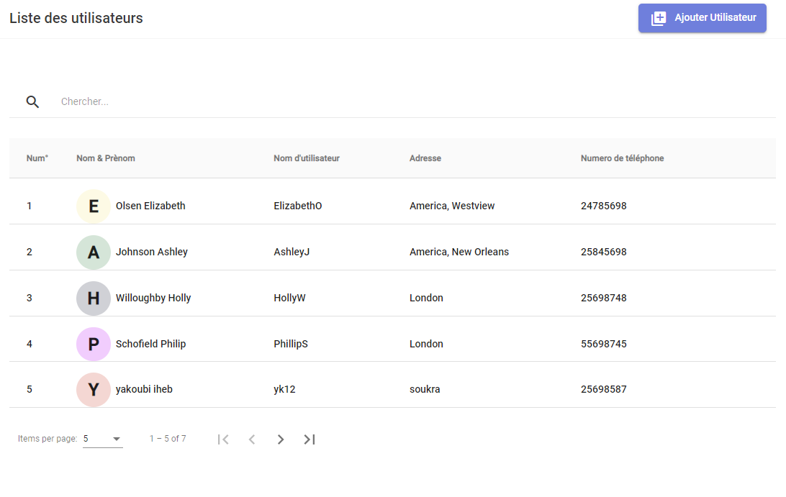
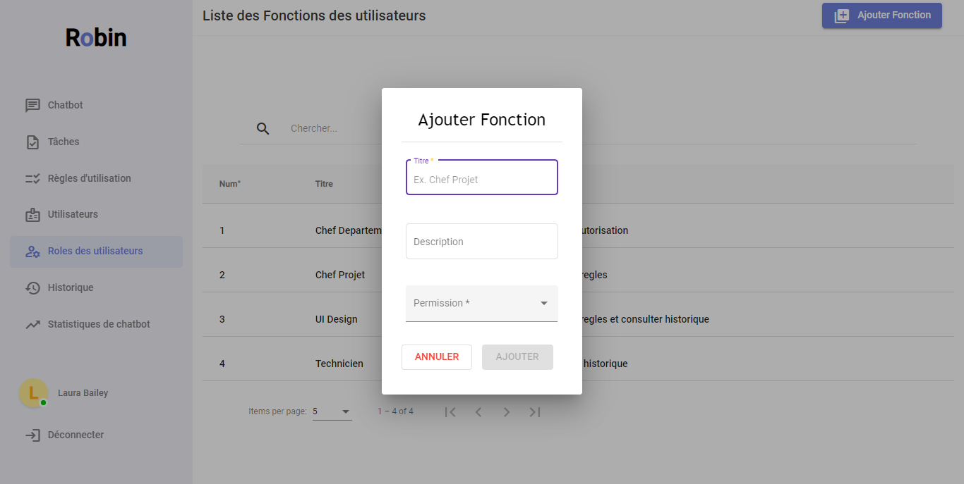
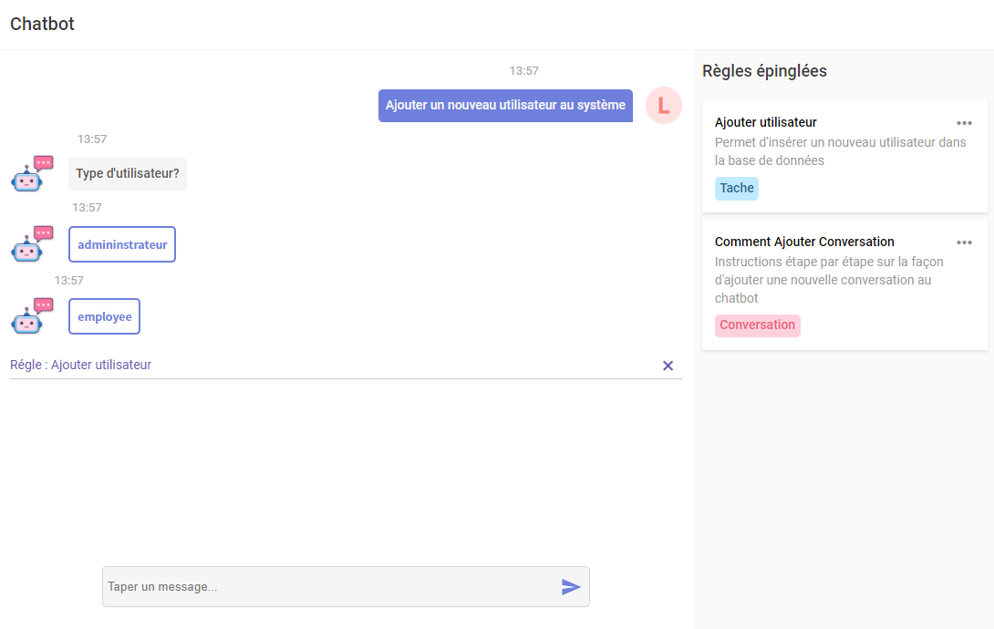
30
Notes:
Yassine: these are our main graphical interfaces,

Slide 40
INTEGRATION TESTS
38

Slide 41
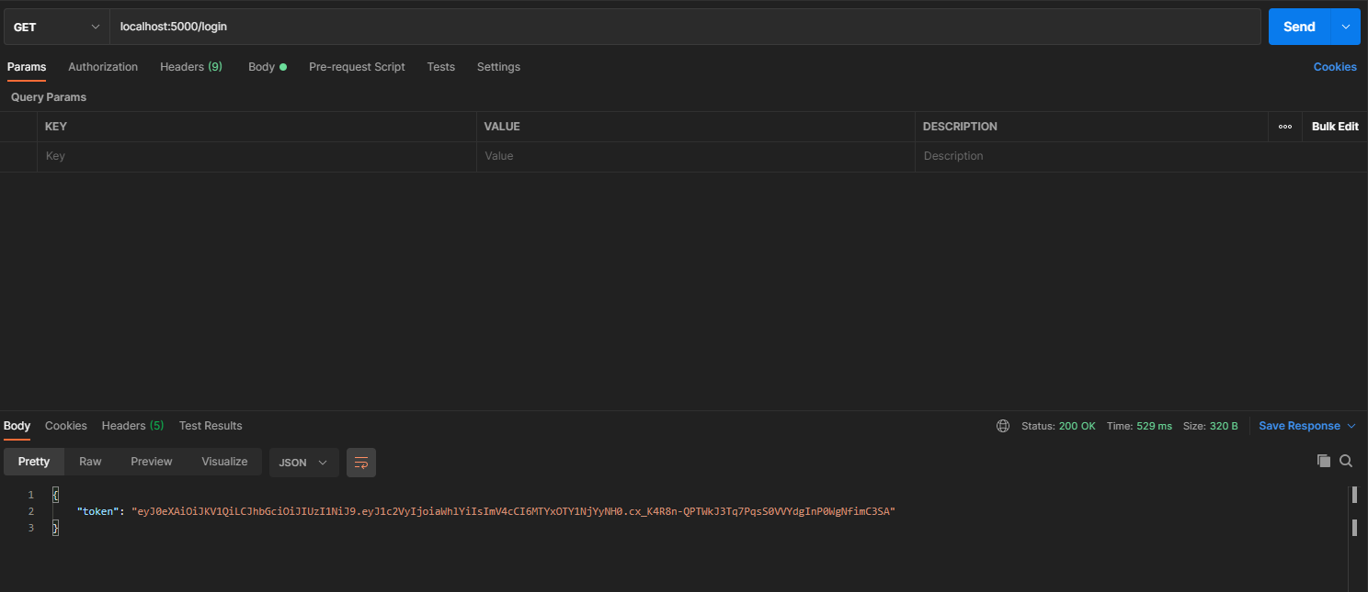
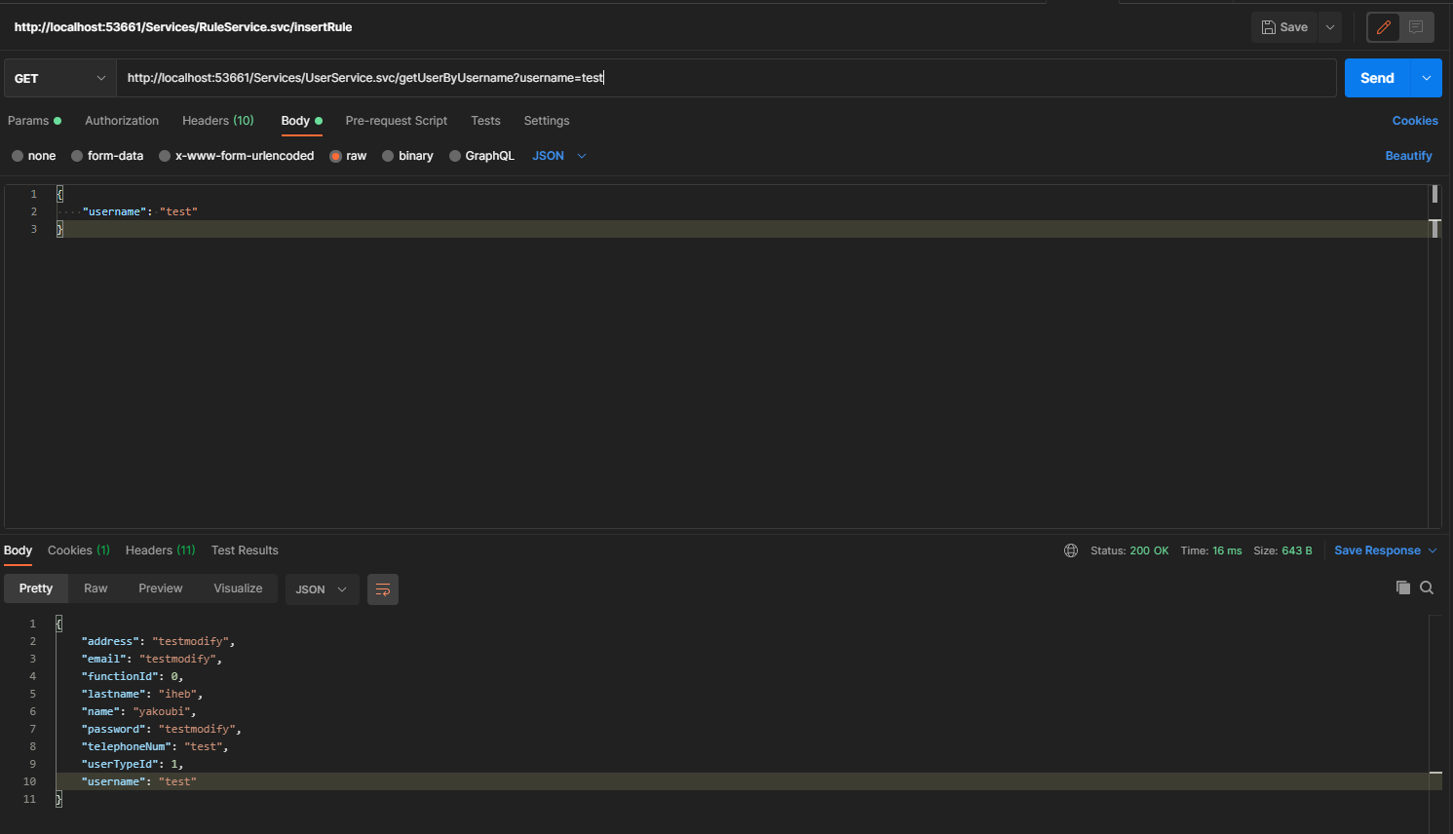
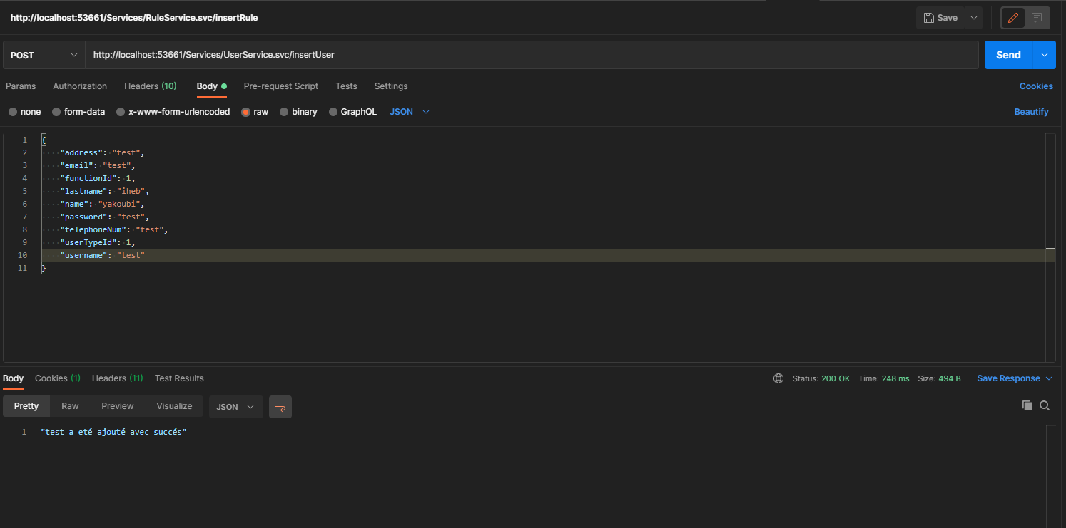
39
Notes:
Iheb: as we said we used postman for the integration tests we tested every single methode in our system, starting by the tests of the backend we can see that the system function perfectly and if we have a look to the time needed to execute the queery 248 ms for a post request and only 16 ms for a get request that ensure us the performance of our system due to the use of one of the fastest functions langages which is c# and for the python also a half second to encode a web token still very good performance sign .

Slide 42

07
CONCLUSION
40
Notes:
Iheb: and last but not least we move to our last chapter where we will conclude everything

Slide 43
01
This project consists of facilitating the use of existing financial applications developed by Prosoft using a chatbot.
02
This project allowed us to explore artificial intelligence.
03
This project allowed us to implement everything we have learned these past three years.
41
Notes:
So first of all this project’s main purpose is to facilitate the use of the existing applications developed by prosoft replacing the old difficult methods with an easy to use chatbot.
And due to that this project allow us to explore a very intresting new skill the artificial intelligence and familiate with its usage.
And finaly it allowed to practice everything we learned for the past three years that we thank you for it.

Slide 44

THANK YOU FOR YOUR ATTENTION
42
Notes:
and we thank you also for your attention

